Slide 1
Welcome!
The webinar will begin at
1:00 Eastern/10:00 Pacific

Slide 2
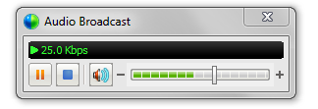
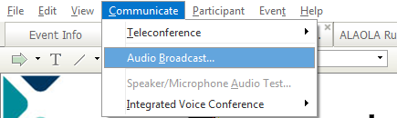
Audio Tips
Today’s audio is streaming to your computer’s speakers or headphones.
Too loud or soft? Adjust volume level in the Audio broadcast box:
Lost all sound? Hear an echo? At the top of the screen, go to the Communicate menu and select Audio Broadcast to refresh your connection.
Notes:
2

Slide 3
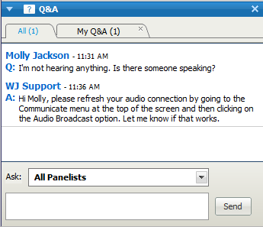
Need Help?
Please post technical support questions into the Q&A Panel.
Step 1: Type the problem in
the dialog box.
Step 2: Click Send.

Slide 4
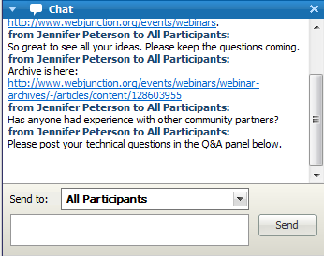
Chat Etiquette
Use Chat to talk with attendees and presenters about the topic.
Do not post technical questions to Chat.
And if you’re tweeting, use this hashtag: #digitalinclusion

Slide 5
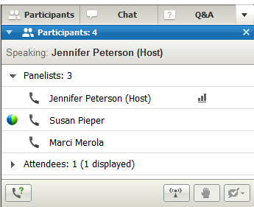
Telephone Access
If you not able to listen via your computer, you may join by phone.
Step 1: Click on Phone Icon under the Participants list.
Step 2: Call the toll-free number provided.
Step 3: Enter the Access Code and Attendee ID provided.
Notes:
http://www.webjunction.org/membercenter/userguide#webex

Slide 6
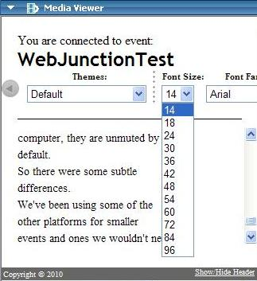
Closed Captioning is available
Open Media Viewer from Panel options.
Adjust font.
Select Show/Hide Header.

Slide 7
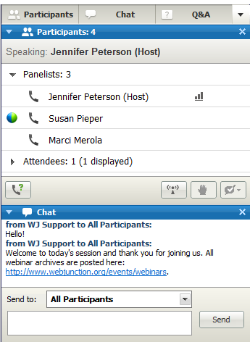
Customize your experience
Panels can be opened or closed by clicking on the panel name at the top of the column, or by using the X in the individual panel.
Hover over edge of
panels to drag and resize.

Slide 8
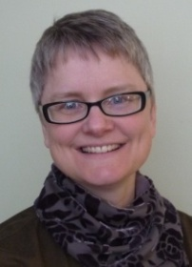
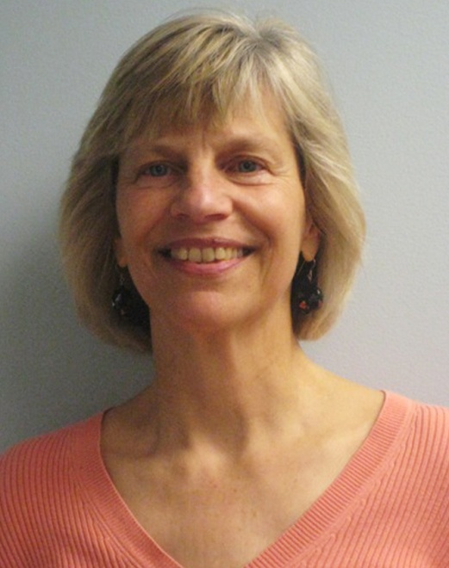
Remember to post to Q&A panel if you need technical assistance.
Other Technical problems?
Contact WebEx support
Event Number: 717 699 718
Phone: 1-866-229-3239
Co-Produced by:
Jennifer Peterson
WebJunction Community Manager
Co-Produced by:
Betha Gutsche
WebJunction
Program Manager
Notes:
8

Slide 9


Thanks to the generous support of the following state library agencies, WebJunction offers webinar programs for free to all who wish to attend:
Arizona State Library, Archives and Public Records
Connecticut State Library
Florida Department of State’s Division of Library and Information Services
Georgia Public Library Service
Idaho Commission for Libraries
Illinois State Library
Indiana State Library
State Library of Kansas
Maine State Library
Minnesota State Library Agency & Minitex
Missouri State Library
State Library of North Carolina
State Library of Ohio
Access Pennsylvania
Texas State Library & Archives Commission
Library of Virginia
Washington State Library

Slide 10
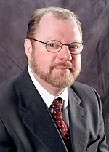
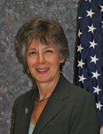
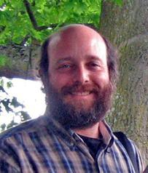
Today’s Presenters
Ron Carlee
Chief Operating Officer, International City/County Management Association
Mary Chute
Deputy Director for Libraries, Institute of Museum and Library Services
David Keyes Community Technology Program Manager, City of Seattle

Slide 11
It Takes a Community to Bridge the Digital Divide

Slide 12

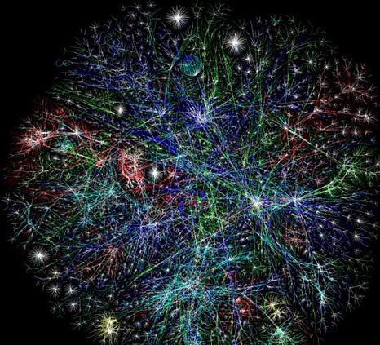
Economic opportunities
Demands on the workforce
Access to government services
Education online
Access to health information
Global social connections
Notes:
“This isn’t just about faster Internet or fewer dropped calls. It’s about connecting every part of America to the digital age. It’s about a rural community in Iowa or Alabama where farmers and small business owners will be able to sell their products all over the world. It’s about a firefighter who can download the design of a burning building onto a handheld device; a student who can take classes with a digital textbook; or a patient who can have face-to-face video chats with her doctor.”
–President Obama, State of the Union Address, January 25, 2011
Also increased demand for computer use in many jobs, most job apps online, government services online, more online education
Photo By anthony_j_ina
By http://www.flickr.com/photos/elifishtacos/ Looking for fish tacos at ELI 2006

Slide 13
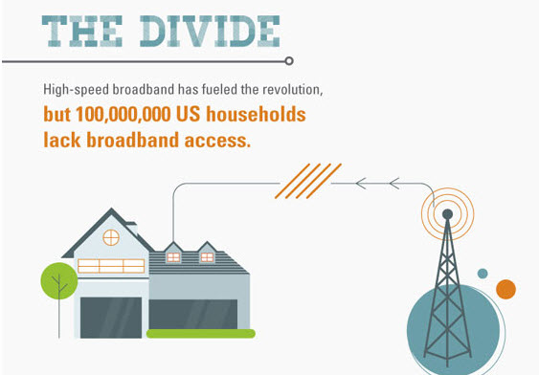
36,555,000
Infographic by Online IT Degree: http://www.famousbloggers.net/digital-divide-infographic.html
Notes:
Infographic from Online IT Degree: http://www.famousbloggers.net/digital-divide-infographic.html
US Census # of households 2010: 114,235,996
NTIA: 68% of households have high-speed bb access (Nov 2011) = 77 680 477
So 36,555,519 lack
28.9% have no Internet or broadband use at home (Oct 2010)
OECD Broadband portal: http://www.oecd.org/document/54/0,3746,en_2649_34225_38690102_1_1_1_1,00.html
Digital Nation report from NTIA: http://www.ntia.doc.gov/files/ntia/publications/ntia_internet_use_report_february_2011.pdf
almost one-third of American households still lack a broadband connection.

Slide 14

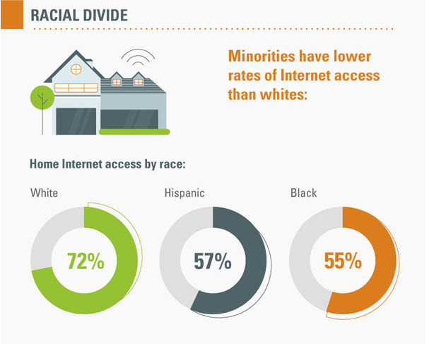


Infographic by Online IT Degree: http://www.famousbloggers.net/digital-divide-infographic.html
Notes:
Racial divide:
slowly narrowing demographic disparities ---big uptick in adoption of smartphones by minorities
White and Asian non-hispanic = > 68% (Oct 2010 data)
Hispanic = 45.2
African-American = 49.9%
Income divide:
ranging from a 32.1 percent adoption rate among persons with $15,000 or less in annual family income,
to 89.6 percent adoption among those with family incomes in excess of $150,000
Urban-rural divide:
Also decreasing gap ---DATA for “households using broadband” ---not nec accounting for speed of connection
Urban = 70.3%
Rural = 60.2%
Education divide:
29.5% for no HS diploma to 84.2% for those with college degree or higher

Slide 15

It takes the
WHOLE COMMUNITY
to make it “OUR” CHALLENGE,
not just “THEIR” problem
Notes:
Getting the community to think of “our” challenge not “their” problem ---everyone owns the challenge

Slide 16
OCLC WebJunction Webinar
March 6, 2012
Building Digital Communities
Mary Chute
IMLS Deputy Director for Libraries

Slide 17
Digital Inclusion Is a Policy Area
Transportation
Employment
Education
Digital inclusion
Health
Energy

Slide 18
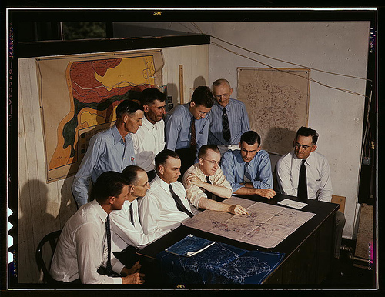
Why Should We Care?
Sectors
  Education, business, health care, government
  Innovative applications
  Business models
Broader society
  Brings new opportunities
  Expands the world
  Enables participation

Slide 19
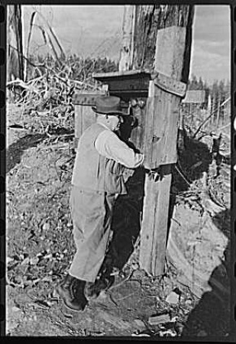
What Are Key Challenges?
Access and broadband deployment
  Geography matters
Adoption and use
  Non-adopters
  Barriers to adoption

Slide 20

Developing the Framework
Cooperative agreement with University of Washington and International City/County Management Association
Digital Inclusion Working Group (16 people)
  Provided iterative feedback on UW draft framework
  Initial in-person meeting, then online
Digital Inclusion Network (80 organizations)
  Larger group of online reviewers
Federal agencies
  Webinar

Slide 21
Building Digital Communities
Vision
Framework
  help community leaders
  initiate community discussions
  conduct asset mapping
  foster digital inclusion
Principles
Goals
Strategies

Slide 22
Principles and Strategic Areas
ACCESS
Availability
Affordability
Design for inclusion
Public access
ADOPTION
Relevance
Digital literacy*
Consumer safety
Economic and workforce development
Education
Health care
Public safety and emergency services
Civic engagement
Social connections

Slide 23
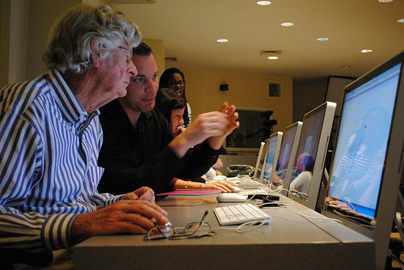
Principle 6: Digital literacy
Goal 1 (1 of 5)
Digital literacy training needs and assets in the community are identified and evaluated, and a strategy for meeting the digital literacy needs of the community is adopted.
Knight Foundation

Slide 24
Sample strategies - digital literacy
Individual
  Help a neighbor connect to the Internet
Libraries, CBOs, and Other Community Anchor Institutions
  Organize a “digital literacy corps” of volunteers to improve digital literacy outreach in the community
Business Sector
  Form partnerships with libraries and CBOs to provide trainers for computer skills classes
Local and Tribal Governing Bodies
  Provide online content and services that are designed for all levels of digital skills
Influencing Policy
  Support strategies to train and provide digital literacy mentors to libraries and CBOs providing community technology services.

Slide 25
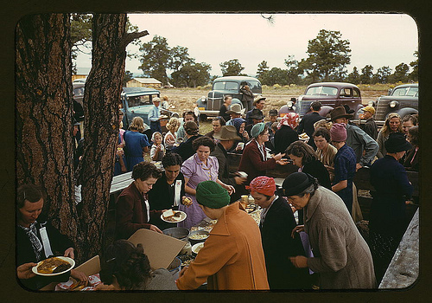
Continuing Efforts
Report Release - Building Digital Communities
  www.imls.gov/about/building_digital_communities.aspx
  (link will be live later in March)
Grant to WebJunction/ICMA/TechSoup
  Summits, community of practice, resources
IMLS Strategic Goal # 2: Community
Next Steps

Slide 26
It Takes a Community to Bridge the Digital Divide
Ron Carlee
Chief Operating Officer
International City/County Management Association

Slide 27
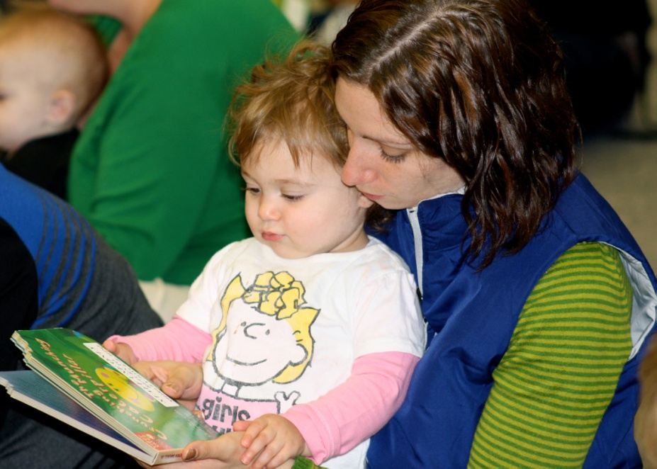
Community collaboration
First phase of the project included direct collaboration with state librarians to engage the community.
  1) Local government,
  2) Libraries,
  3) CBOs and community institutions,
  4) Businesses, and
  5) Individuals.

Slide 28
Findings
Communities recognize the pressing need for digital inclusion.
Efforts are stove-piped and uneven.
The proposed Framework was helpful in identifying issues of digital inclusion.
Leading practices would be valuable to individual communities.
Look & feel will vary.

Slide 29
The forums
Three locations:
  Los Angeles, CA;
  Oklahoma City, OK;
  Bangor, ME
Comprised of two separate sessions
  Residents (state and local)
  Key stakeholders
Community forums
  Plenary sessions & small group sessions

Slide 30
Implementing Building Digital Communities: A Framework for Action
Convene stakeholders
Develop a shared community understanding of digital inclusion
Create a community action plan
Implement the plan
Evaluate and revise the plan

Slide 31
Resources
http://icma.org/libraries
www.icma.org

Slide 32
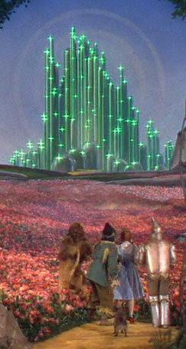


David Keyes
City of Seattle
Seattle.gov/tech
@diginclusion

Slide 33
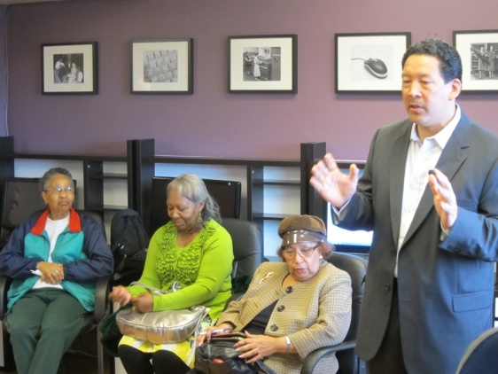
                Seattle Community Technology Program
                Since 1996!
  Foundations
    Digital inclusion wraps around all other activities and values
    People get it, but may not have the experience in how to apply it
    Use and build capacity of diverse community orgs/institutions
    Build internal partners too
    Community need and program
    assessments are ongoing

Slide 34
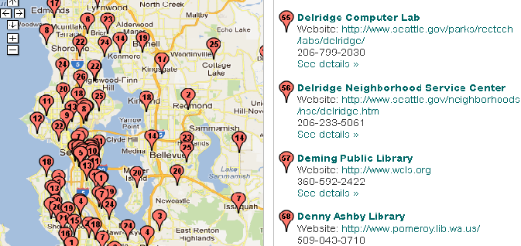
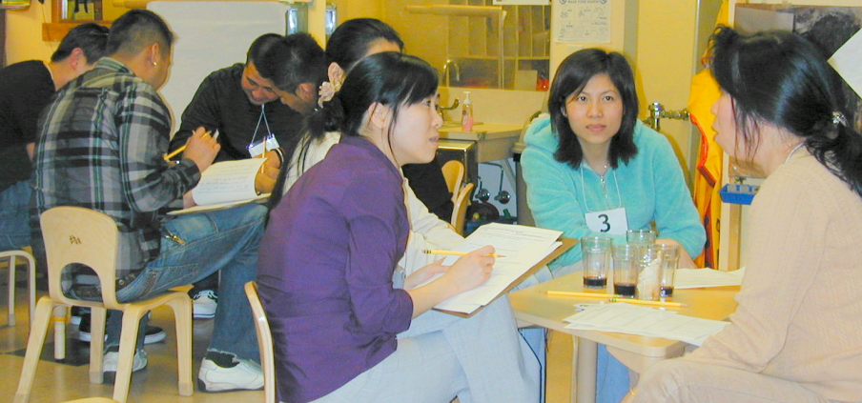
Seattle Digital Inclusion Programs
  City Digital Inclusion Strategic Planner and staff
  “Techmap”
  Research:
  IT Indicators, Focus Groups

Slide 35
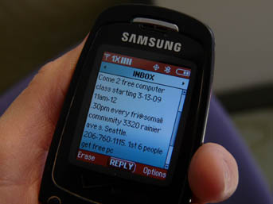

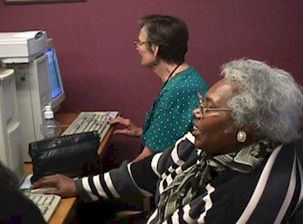

Seattle Digital Inclusion Programs
  Technology Matching Fund &
  Communities Online Boost Grants
  Seniors Training Seniors
  Youth E-Civic Engagement

Slide 36


Seattle Digital Inclusion Programs
  Internet Terminals and
  RecTech Community Center Labs
  Cable Broadband for NPO’s
  Get Online Week & Education
  Race & Social Justice IT Project Management Tool

Slide 37

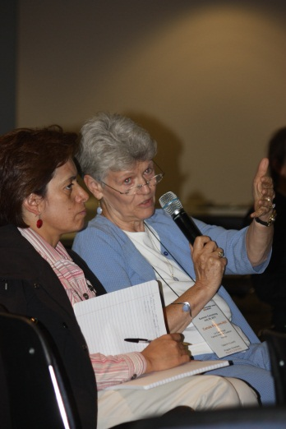
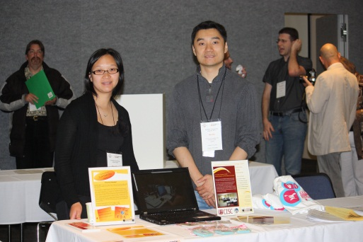
  Advancing digital inclusion in Washington State
  Responded to need for coordination and capacity building
  Founded by broad stakeholders
  Managed by EdLab Group

Slide 38
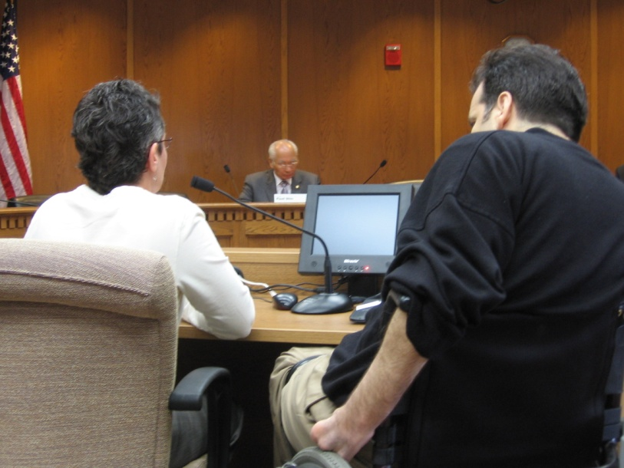
  Use access – literacy – content framing
  Developed state definition of digital inclusion/ community technology
  Established state funding program
  Created State Council on Digital Inclusion
  BTOP project

Slide 39

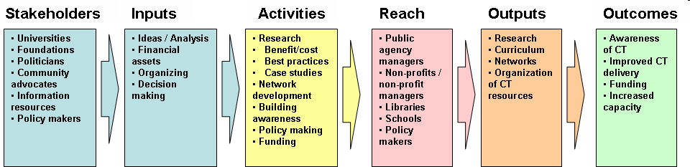
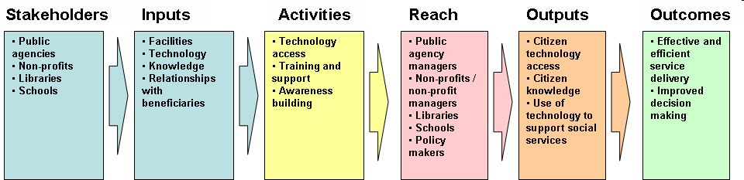
Eval Partnership & Cascading Outcomes
Systemic Model (Capacity Building)
Human Capital
Technology
Workforce Development Outcome Model
Youth Development Outcome Model
Financial Services Outcome Model

Slide 40

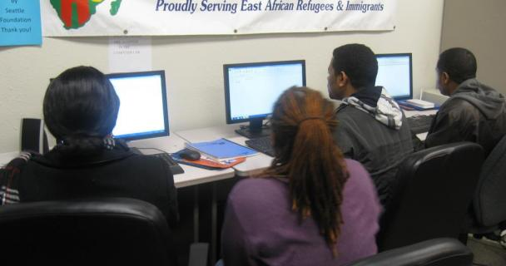
Current BTOP Project
28 Community & Public Housing Resource Centers
5 Public Libraries
2 Courthouses
Workforce Development Council
JusticeNet/ State Access to Justice Board
NPower Northwest

Slide 41
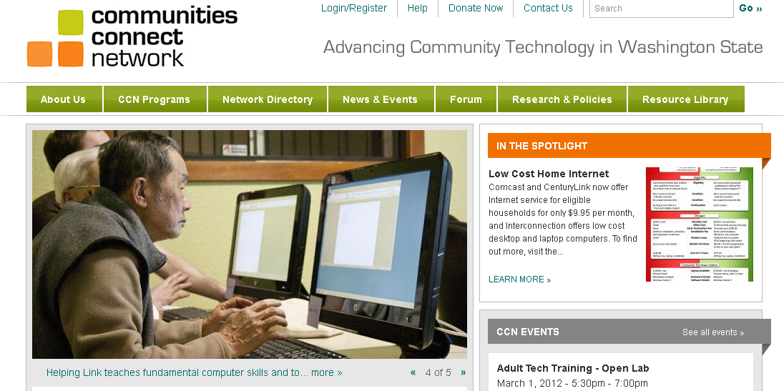
Communitiesconnect.org resource hub promotes public computing sites, training, best practices, low cost Internet, and partners

Slide 42

“Electric lights are different. Electricity is not in any sense a necessity, and under no conditions is it universally used by the people of a community. ..It is not the business of any one to see that I use electricity, or gas, or oil in my house, or even that I use any form of artificial light at all.”
Oct. 24, 1905, in the Richmond, Virginia,
Times-Dispatch

Slide 43



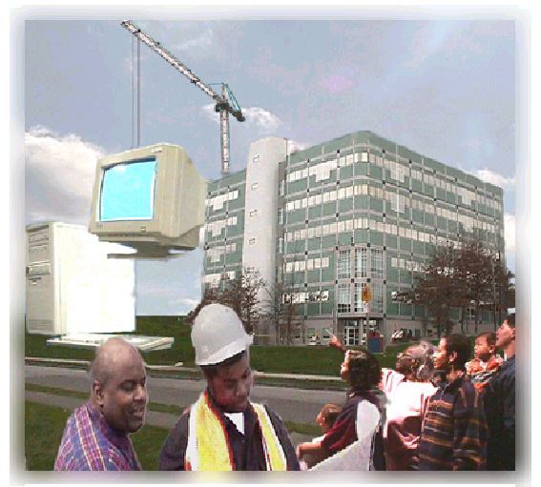


Building blocks for building communities
Seattle.gov/tech
@diginclusion

Slide 44

Questions and Comments

Slide 45
Stay Involved
IMLS
    imls.gov/about/building_digital_communities.aspx
    (link will be live later in March)
On WebJunction
  webjunction.org
Crossroads (monthly newsletter)
  webjunction.org/crossroads
Events
  webjunction.org/events/webinars

